Slide 1


Advanced Applications of Systems Modeling &Simulation ::Multiple Runs
Dr. Xueping Li
University of Tennessee, Knoxville

Slide 2
How to Make Multiple Runs
The need
Ad hoc multiple runs??
Recall HW#2 open question
Let’s simply use the “case study – 2” as an example
Save as “Phase-3”

Slide 3
New modules
Parameter
Dataset

Slide 4
Parameter variation

Slide 5
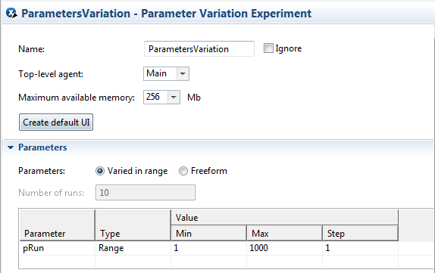
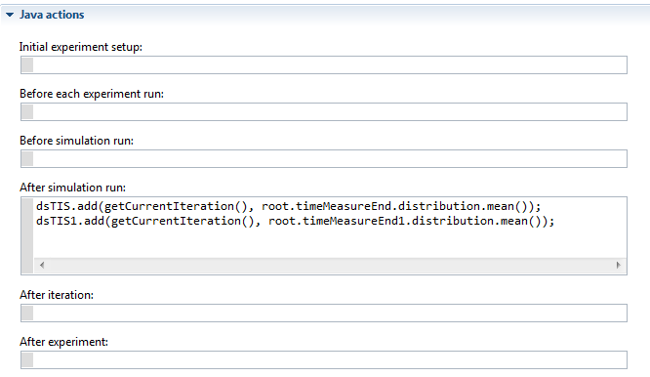

Slide 6
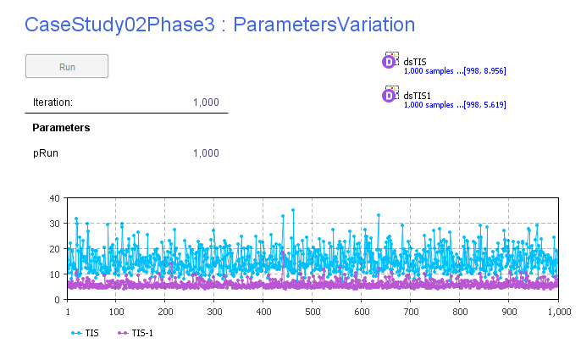

Slide 7
How many runs are needed??

Slide 8
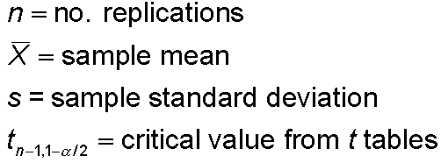


Half Width, Number of Replications
Prefer smaller confidence intervals — precision
Notation:
Confidence interval:
Half-width =
Can’t control t or s
Must increase n — how much?
Want this to be “small,” say
< h where h is prespecified

Slide 9



Half Width, Number of Replications (cont’d.)
Set half-width = h, solve for
Not really solved for n (t, s depend on n)
Approximation:
Replace t by z, corresponding normal critical value
Pretend that current s will hold for larger samples
Get
Easier but different approximation:
s = sample standard
deviation from “initial”
number n₀ of replications
n grows quadratically
as h decreases
h₀ = half width from “initial” number n₀ of replications

